Slide 1
Predicting high engagement from Reddit posts

Slide 2
Problem statement
Reddit offers a large community of users who interact with threads about a variety of topics and who can contribute opinions and insights on particular issues
According to Foundation, a market content research firm, Reddit has 330 million monthly active users
The marketing team at FiveThirtyEight, a data-driven media organization, desires to identify the characteristics of a Reddit post that are most predictive of a high level of engagement as measured by the number of comments associated with a post

Slide 3
Data Collection
Using web-scraping and Selenium, over 10,000 Reddit threads were collected in December, 2021 and early January 2022
The following features were collected from Reddit posts: Thread title, time since it was posted, subreddit, whether the post contained a video, whether the post contained an image, and the number of comments

Slide 4
Exploratory Data Analysis
Features considered in this analysis included:
Thread length
Percentage of characters that are upper case
Whether a post was framed as a question
Thread polarity
Thread subjectivity
Number of emojis in the threads
Count of posts per subreddit
Number of punctuation signs used
The amount of time since the thread was posted
Whether the thread contained a video or image
Whether the thread was posted on a holiday

Slide 5
Exploratory Data Analysis
Foundation’s analysis stated that: “posts with questions” generate more than 2 times the number of comments as posts that do not contain questions
In the data collected, it is clear that the average number of comments among posts posed as a question is significantly higher than the average number of comments among posts that are not posed as a question

Slide 6
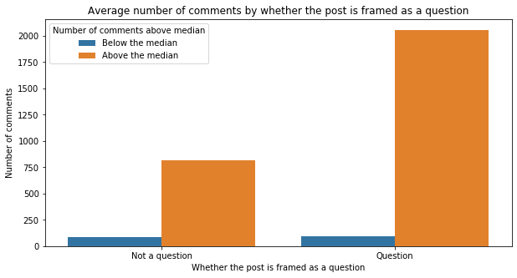
Exploratory Data Analysis

Slide 7
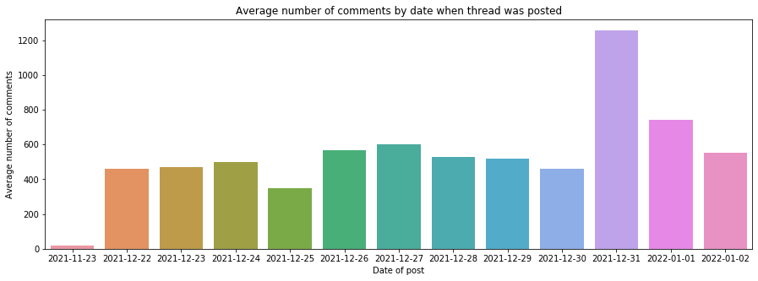
Exploratory Data Analysis
Threads that were posted around a holiday or 12-30-2021 to 01-01-2022 were associated with a higher number of average comments

Slide 8
Modeling and model evaluation
Use selected features and tokens derived from a CountVectorizer and Tfidf Vectorizer to find the words and features in the threads that are most predictive of a number of comments above the median
The best model was the model with the highest accuracy and precision scores:
The class that should be predicted accurately most of the time is the positive class; therefore, the model that maximizes the precision score according to this criteria is the best model

Slide 9
Modeling and evaluation using Tfidf Vectorizer
Model | Accuracy | Precision score
Decision Tree | 0.64 ± 0.014 | 0.624
Bagging Classifier | 0.69 ± 0.016 | 0.723
Random Forest | 0.72 ± 0.018 | 0.736
Extra Trees Classifier | 0.7 ± 0.017 | 0.708
K-nearest neighbor | 0.66 ± 0.0077 | 0.605

Slide 10
Results
A longer amount of time since a thread was posted increases the odds of a post having a number of comments above the median
Posts that are framed as questions are 1.3 times more likely to have a number of comments above the median than posts that do are not posed as a question
Posts that were posted during a holiday were 1.2 times more likely to have a number of comments above the median than posts that were not posted during a holiday
Threads that had the following characteristics tended to be classified as having a number of comments above the median:
* For threads that had a question in their title
* And, had been posted for more than 12 hours, and had a low degree subjectivity and polarity, around 200 (2% of 10,000 threads) of them were classified as having a number of comments above the median

Slide 11
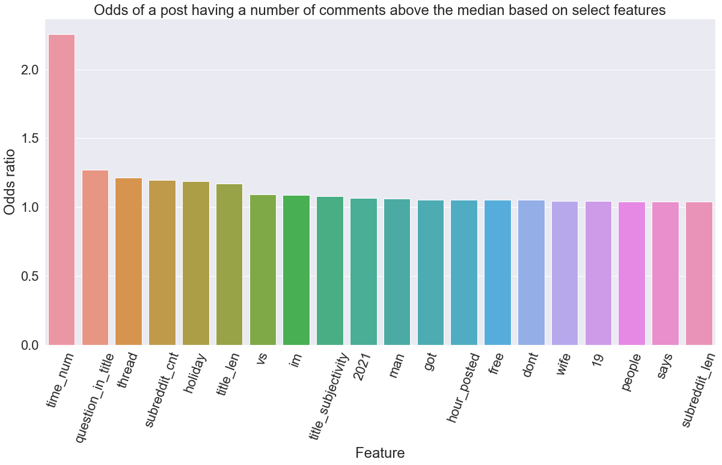
Odds ratios of logistic regression of features to predict a high level of engagement

Slide 12
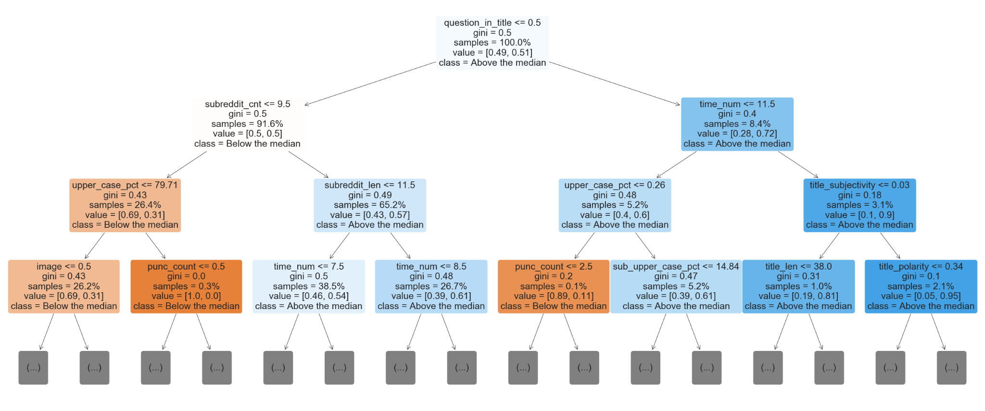
Decision Tree

Slide 13
Discussion
* From a marketing perspective, Reddit is a community of individuals who can serve as a testing ground for `wh-` type questions related to a product. For instance, what features would a user like to see in a product, what price would redditors be willing to pay for a product, and more. The marketing office at `FiveThirtyEight` specifically can use Reddit to ask what social issues are of greater concern or importance within the Reddit community to plan for what content to work on in the future.
* In addition, posts that have been up on Reddit for less than 12 hours are classified as having a number of comments above the median. Therefore, marketed content should be up on Reddit for a significant amount of time but the frequency used to refresh the content should be determined.
* Holidays may be days when redditors have more time to be engaged in social media. Therefore, consider posting content during holidays to increase engagement.
* Further analysis should be done to identify what specific tokens are associated with a post being classified as having a high number of comments

